Slide 1
Weatherdock Academy
AIS SART vs. AIS MOB
Differences | Applications

Slide 2
How does AIS help in emergency situations?
AIS based rescue transmitters are used to alert ships in the vicinity when activated in a man over board situation.
Functionality
Transmission of an AIS emergency telegram after activation of a rescue transmitter
Receipt of the telegram from all AIS systems (Class A & Class B) in the immediate vicinity
Rapid rescue of the victim by nearby ships thanks to the transmission of dynamic data (position, course and speed) from the rescue transmitter
AIS SART vs. AIS MOB

Slide 3
Which data are transmitted?
Static Data
Unit-ID of the Rescue Transmitter
Dynamic Data
Position of the victim
Curse over ground (COG)
Speed over ground (SOG)
AIS SART vs. AIS MOB

Slide 4
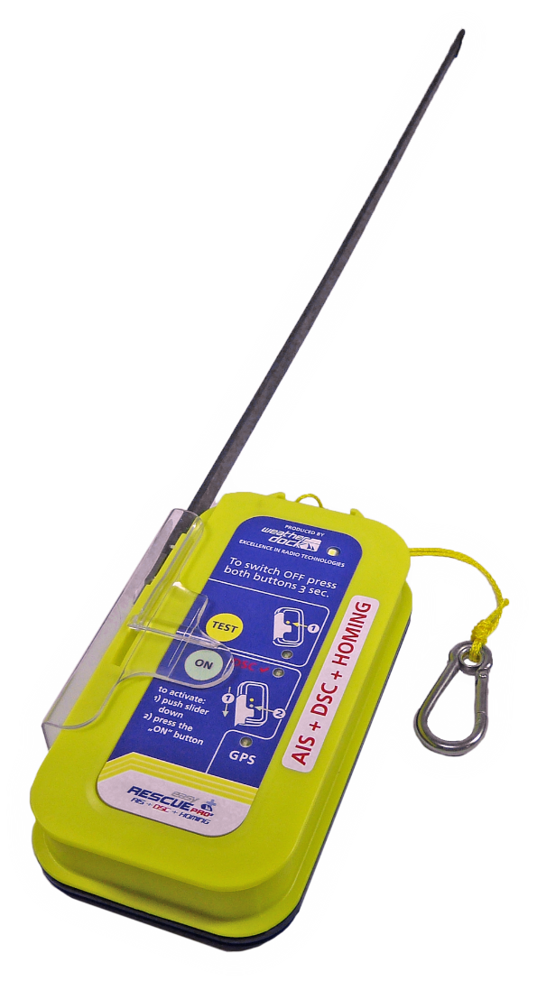
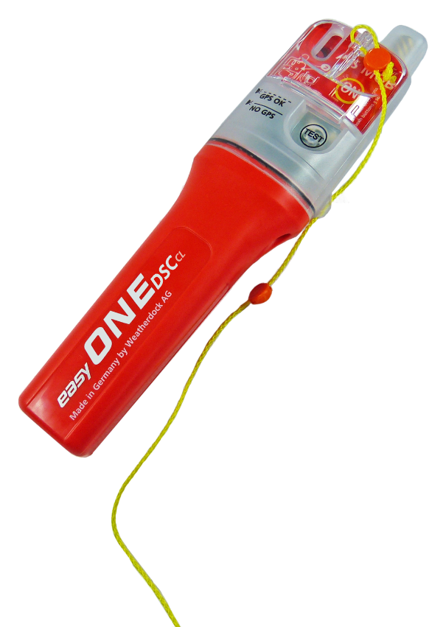
AIS in emergency situations
?
AIS Rescue Transmitter
MOB
Man Over Board Unit
SART
Search And Rescue Transmitter
AIS SART vs. AIS MOB

Slide 5
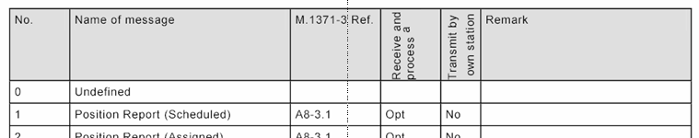
AIS SART
Use of AIS in emergency situations
Use of the AIS standard frequencies
Telegram type 01 (position report) for GPS position determination
Telegram type 14 (Safety Related Broadcast Message)
The victim's own ship sees the exact position
Every ship in the transmission range with AIS reception on board receives this message and can intervene to help
AIS SART vs. AIS MOB

