Slide 1
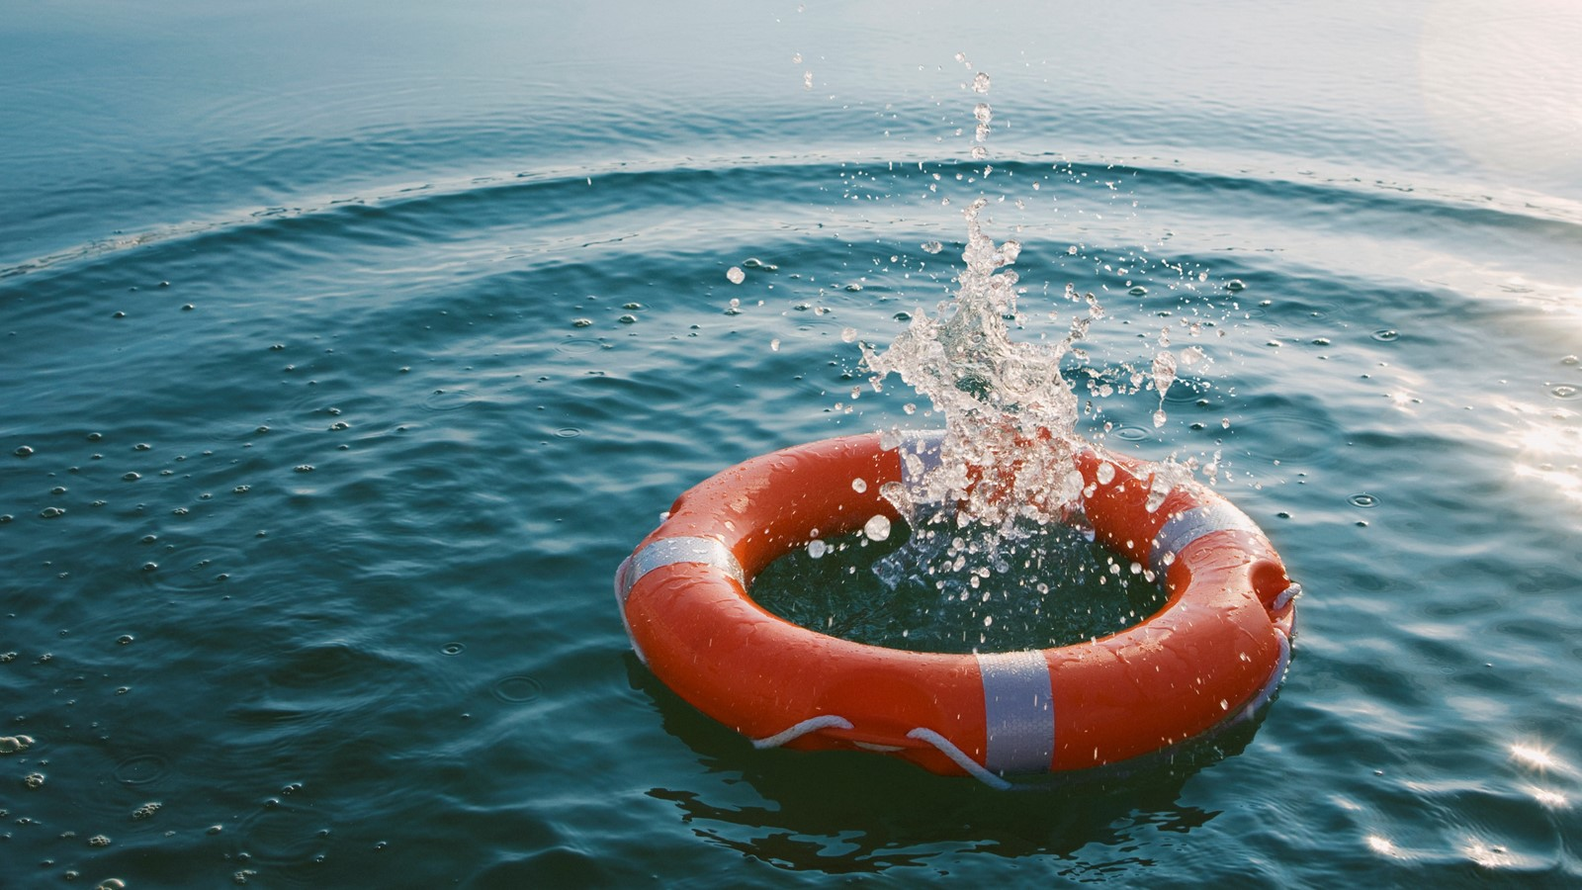
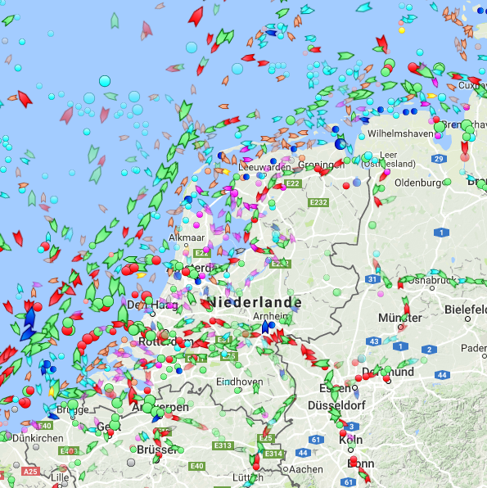

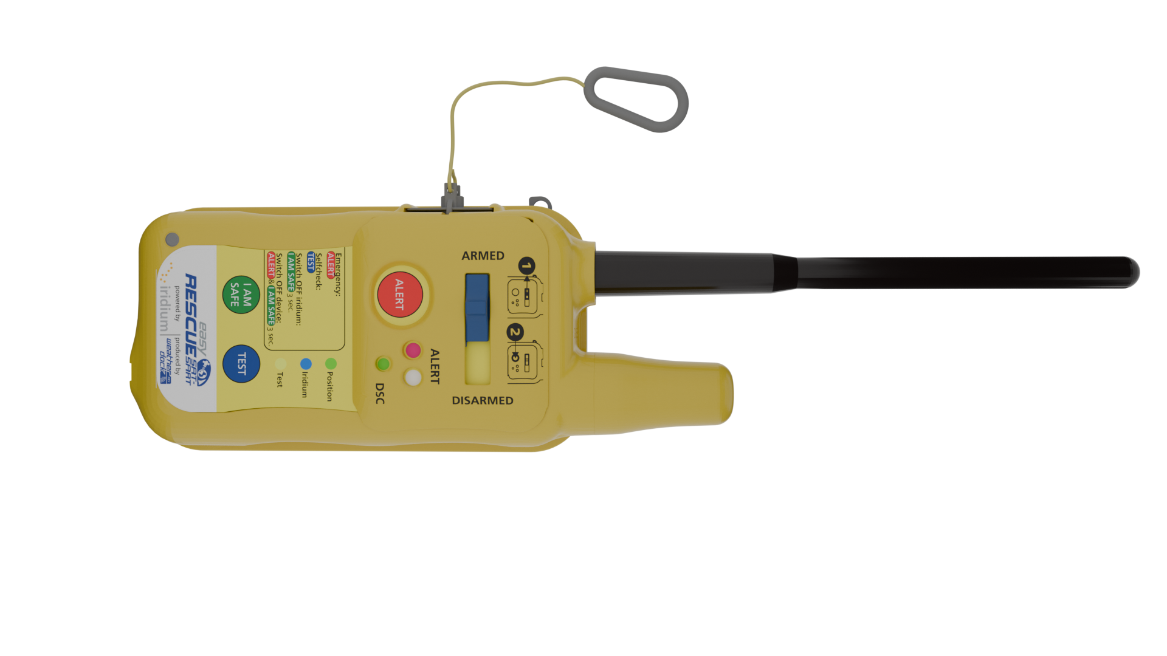
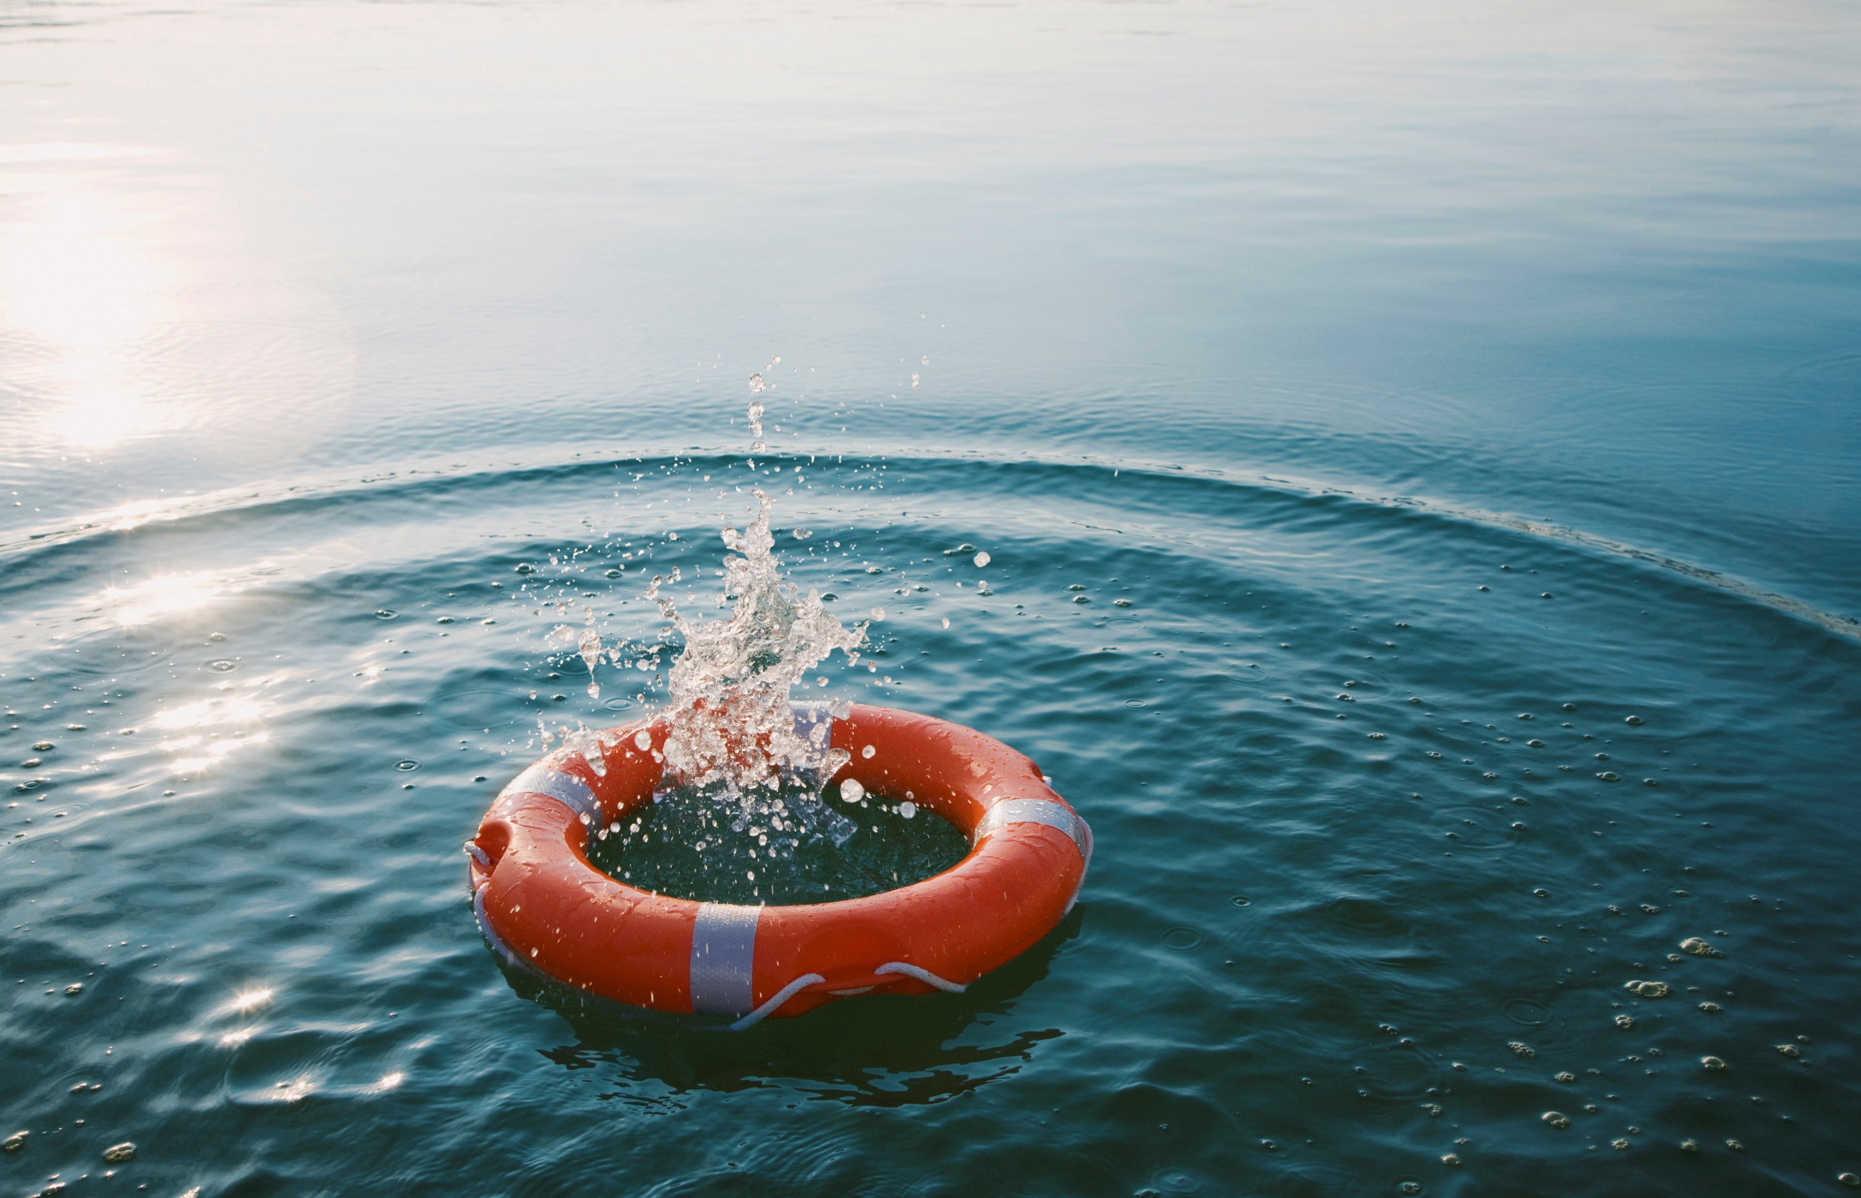
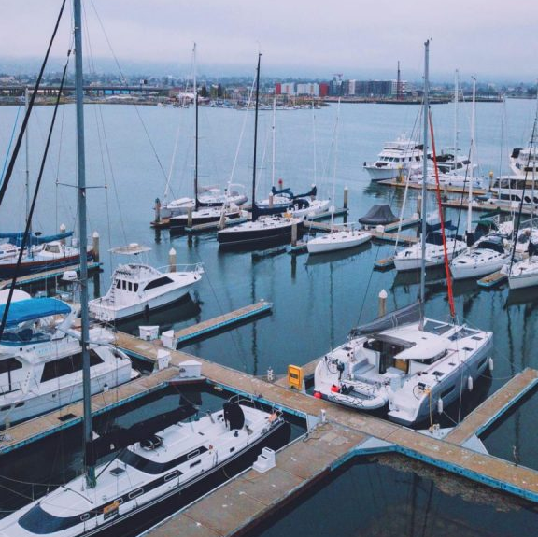





easyRESCUE-SAT-SART | SAFETY
AIS SART
Satellite based alerting on iridium
SOLAS certified
100% world wide covearge via iridium satellite network
Full automatic activation
Battery driven unit

Slide 2
easyRESCUE-SAT-SART | SAFETY
Iridium GMDSS „Localized At-Sea Rescue System
First handheld PLB/LASRS with iridium
AIS + iridium combination
US Satellite network
SOLAS approved (AIS)

Slide 3
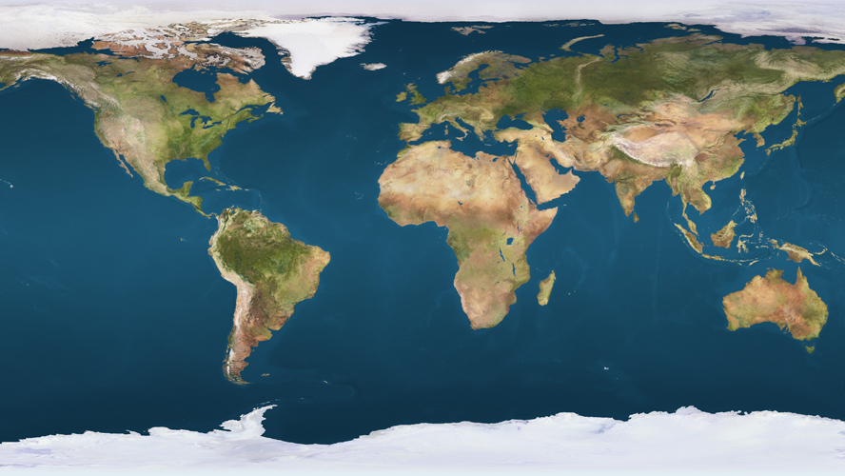
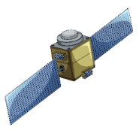
Iridium® Satellite Network
Every Iridium satellite is linked to 4 other satellites to create a mesh of satellites.
This allows a maximum speed of communication to forward the distress call asap to the rescue organization.

Slide 4
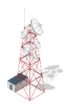
Iridium distress call
The distress signal transmitted from the easyRESCUE SATSART is picked up from the nearest by satellite unit and automatically forwarded into the network to reach the closest ground station.

Slide 5
Discover the huge functionality of the new
easyRESCUE-SATSART
Just click and get it!

Slide 6
Magnetic Slider
Has to be on the left side for „armed“ status. Automatic activation in case of emergency will only work in „armed“ position.
BACK

Slide 7
ALERT button
Activation in case of emergency can be done manually by pressing the red ALERT button.
BACK

Slide 8
Hook for life jacket
By using this hook, the cord of the magnetic switch can be fixed on the liefe jacket.
In case of inflatement of the jacket, the cord becomes to short and the magnetic switch is torn away from the unit which activates the unit automatically.
BACK

Slide 9
Button „I Am Safe“
Gives the possibility to cancel the iridium GMDSS distress call in case when the situation could have been cleared within a few minutes.
Iridium connection will shutted down.
BACK

Slide 10
Magnetic Switch
Pulling off the magnetic switch will automatically activate the unit to send out AIS and iridium distress signals.
BACK

Slide 11
TEST button
A full system check will be done after pressing this button including battery check, AIS and iridium functionality.
BACK

Slide 12
Iridium antenna
The bi-directional 2way communication with the ridium satellite network is broadcasted and received via this antenna
BACK

Slide 13
VHF antenna
The broadcasting of the AIS emergency signal into the AIS traffic on both channels s done via this antenna
BACK

Slide 14
Water contact
In case the unit is submerged for more than 2 sec., the unit is activated automatically and starts transmitting
Iridium and AIS
BACK

Slide 15
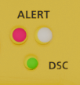
Status LEDs
In case of emergency activation a bright white LED will flash as well as a green LED for DSC activity. Additional there is an infrared LED which can be detected from planes and helicopters.
BACK

Slide 16
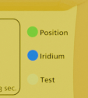
Status LEDs
These LEDs inform about established Iridium con-nection, about established GPS position and TEST mode.
BACK

